Slide 1
Angular
Anil K

Slide 2
Animations
Animation is a process of changing css property value gradually based on the time limit. That means within the specified time limit, the property will change from “start value” to “end value”.
Angular animations are used to invoke the css animations programmatically through the component.

Slide 3
Steps for working with Animations:
• Import "@angular/animations" package in "package.json" file:
"@angular/animations": "5.0.0",
• Import "BrowserAnimationsModule" in "app.module.ts":
import { BrowserAnimationsModule } from "@angular/platform-browser/animations";
• Import "BrowserAnimationsModule" into "AppModule":
@NgModule({ , imports: [BrowserAnimationsModule] })
class AppModule {
}
• Import "trigger", "state", "style", "transition", "animate" in "app.component.ts":
import { trigger, state, style, transition, animate } from "@angular/animations";

Slide 4
Steps for working with Animations:
• Define animation:
var myanimations = [
trigger("animationname", [
state(state1 , style({ cssproperty: "value" })),
state(state2", style({ cssproperty:"value"})),
transition("state1 => state2", animate("milli seconds")),
transition("state2 => state1, animate("milli seconds"))
])
];
• Import animation in the component:
@Component({ , animations: myanimations})
class AppComponent {
}
• Define property in the component:
@Component({ , animations: myanimations})
class AppComponent {
propertyname : datatype = "stater;
}

Slide 5
Steps for working with Animations:
• Map "property" of the component to "animation":
<tag [@animationname]="propertyname"> </tag>
• Change the value of the "property" of the component:
@Component({ , animations: myanimations })
class AppComponent {
propertyname : datatype = "state1;
method() {
this.propertyname = "state2";
}
}

Slide 6
Animations - Example
Steps
• Command Prompt
npm install @angular/cli -g
cd c:\angular
ng new myapp
cd c:\angular\myapp
ng serve

Slide 7
c:\angular\myapp\src\app\app.component.ts
import { Component } from "@angular/core";
import { trigger, state, style, transition, animate } from "@angular/animations";
var myanimations = [
trigger("animation1", [
state("visible", style({ transform: "scale(1)" })),
state("invisible", style({ transform: "scale(0)" })),
transition("visible => invisible", animate("500ms")),
transition("invisible => visible", animate("800ms")),
])
];

Slide 8
c:\angular\myapp\src\app\app.component.ts
@Component({
selector: "app-root",
templateUrl: "app.component.html",
animations: [myanimations]
})
export class AppComponent {
currentstate: string = "visible";
ShowData() {
this.currentstate = "visible";
}
HideData() {
this.currentstate = "invisible";
}
}

Slide 9
c:\angular\myapp\src\app\app.component.html
<div>
<h1>Animations</h1>
<input type="button" value="Show Data" (click)="ShowData()">
<input type="button" value="Hide Data" (click)="HideData()">
<div [@animation1]="currentstate" style="background-color:#77cae8; height: 100px"> Hello </div>
</div>

Slide 10
c:\angular\myapp\src\app\app.module.ts
import { BrowserModule } from '@angular/platform-browser';
import { NgModule } from '@angular/core';
import { FormsModule } from '@angular/forms';
import { AppComponent } from './app.component';
import { BrowserAnimationsModule } from '@angular/platform-browser/animations';
@NgModule({
declarations: [ AppComponent ],
imports: [BrowserModule, FormsModule, BrowserAnimationsModule ],
providers: [ ],
bootstrap: [AppComponent]
})
export class AppModule { }

Slide 11
c:\angular\myapp\src\main.ts
import { enableProdMode } from '@angular/core';
import { platformBrowserDynamic } from '@angular/platform-browser-dynamic';
import { AppModule } from '../app/app.module';
import { environment } from './environments/environment';
if (environment.production) {
enableProdMode();
}
platformBrowserDynamic().bootstrapModule(AppModule)
.catch(err => console.log(err));

Slide 12
c:\angular\myapp\src\index.html
<!doctype html>
<html lang="en">
<head>
<meta charset="utf-8">
<title>Myapp</title>
<base href="/">
<meta name="viewport" content="width=device-width, initial-scale=1">
<link rel="icon" type="image/x-icon" href="favicon.ico">
</head>
<body>
<app-root></app-root>
</body>
</html>

Slide 13
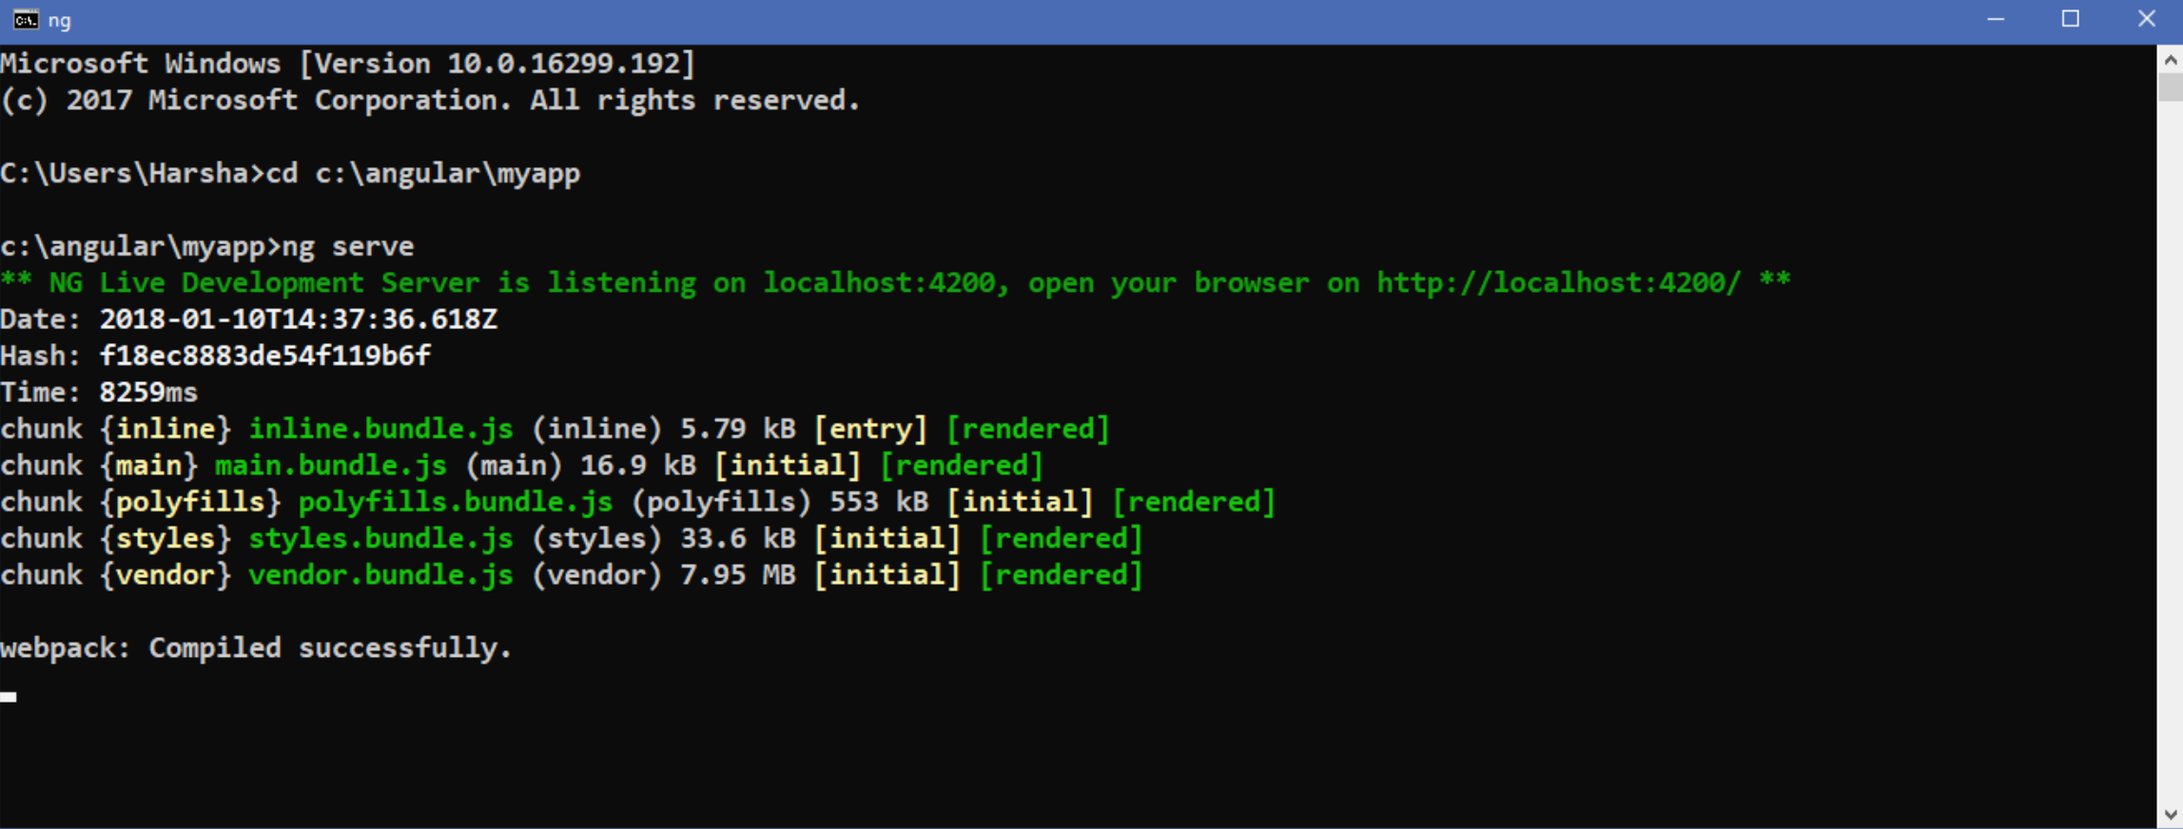
Executing the application:
Open Command Prompt and enter the following commands:
cd c:\angular\myapp
ng serve

Slide 14
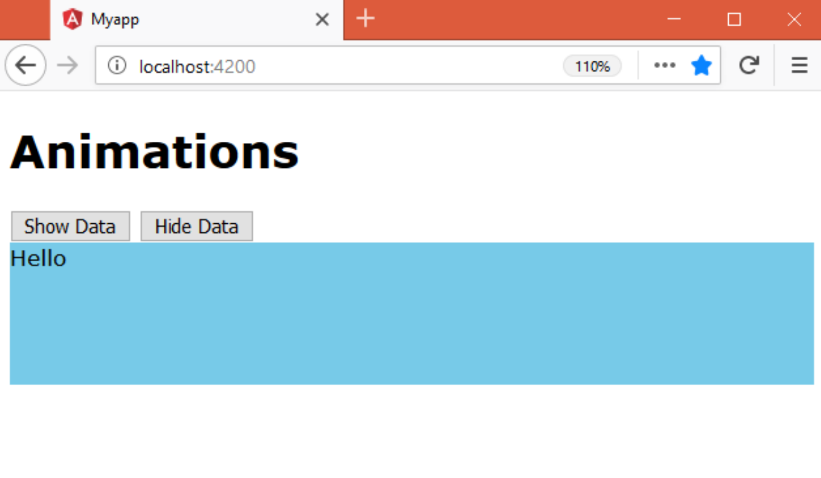
Open the browser and enter the following URL:
http://localhost:4200

